Slide 1

Chapter 10 – part II

Slide 2
OUTLINE
  Angular momentum.
  Gyroscopes and precession.
  Problems.

Slide 3

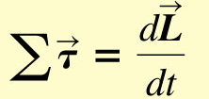
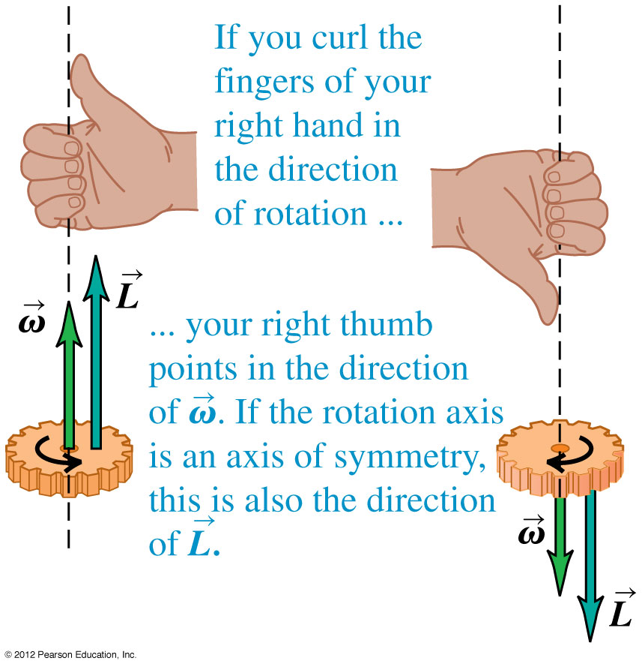
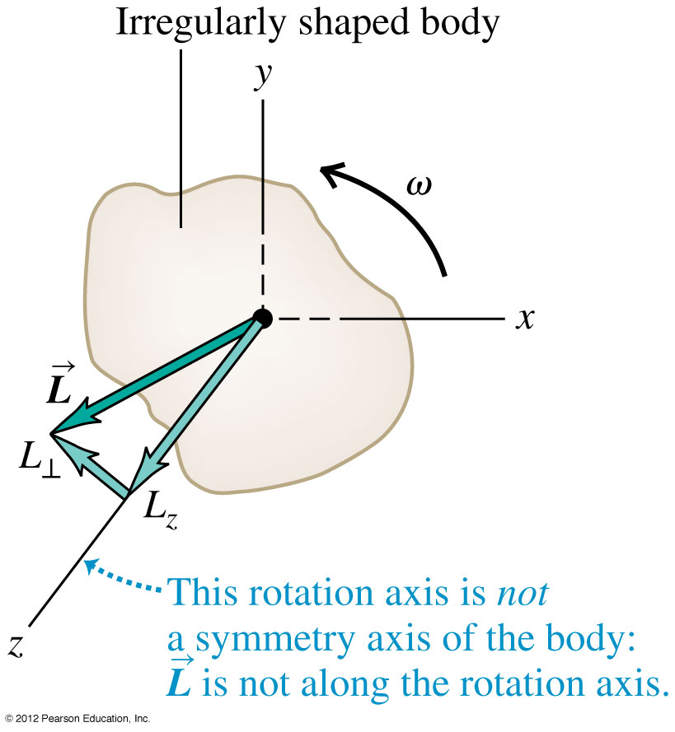
Angular momentum
The angular momentum of a rigid body rotating about a symmetry axis is parallel to the angular velocity and is given by
For any system of particles

Slide 4
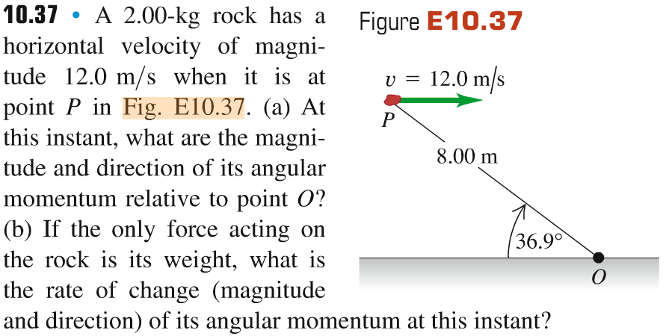
Problem #1

Slide 5
Problem #2

Slide 6
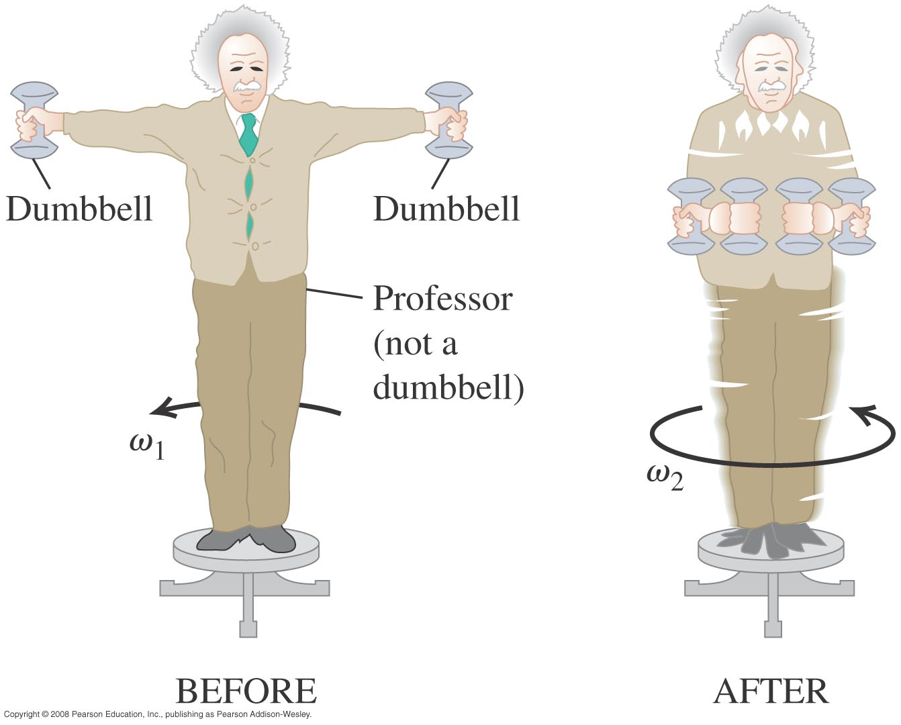
Conservation of angular momentum
When the net external torque acting on a system is zero, the total angular momentum of the system is constant (conserved).

Slide 7
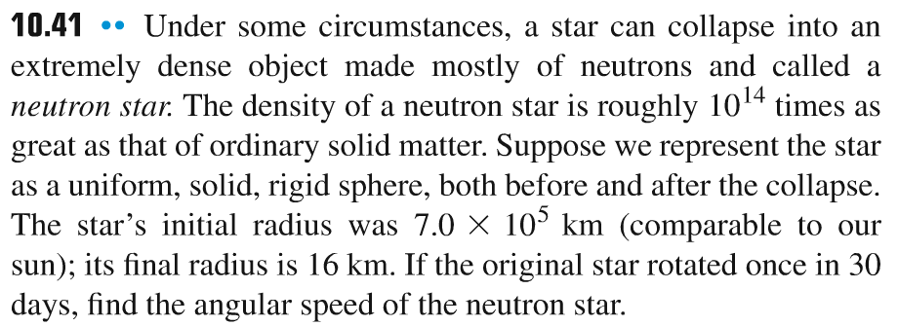
Problem #3

Slide 8
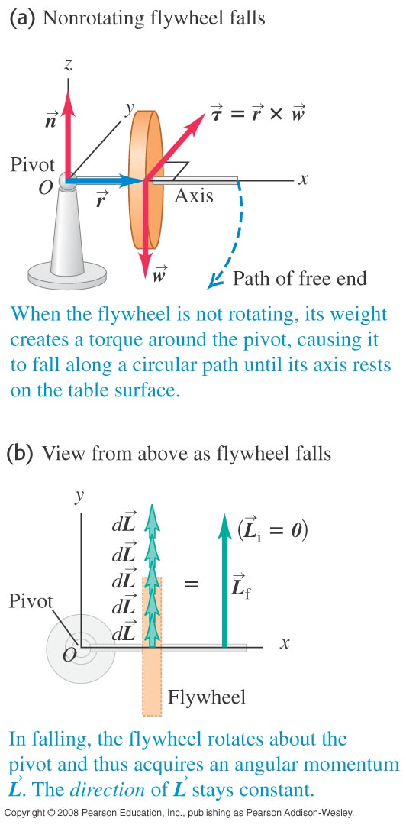
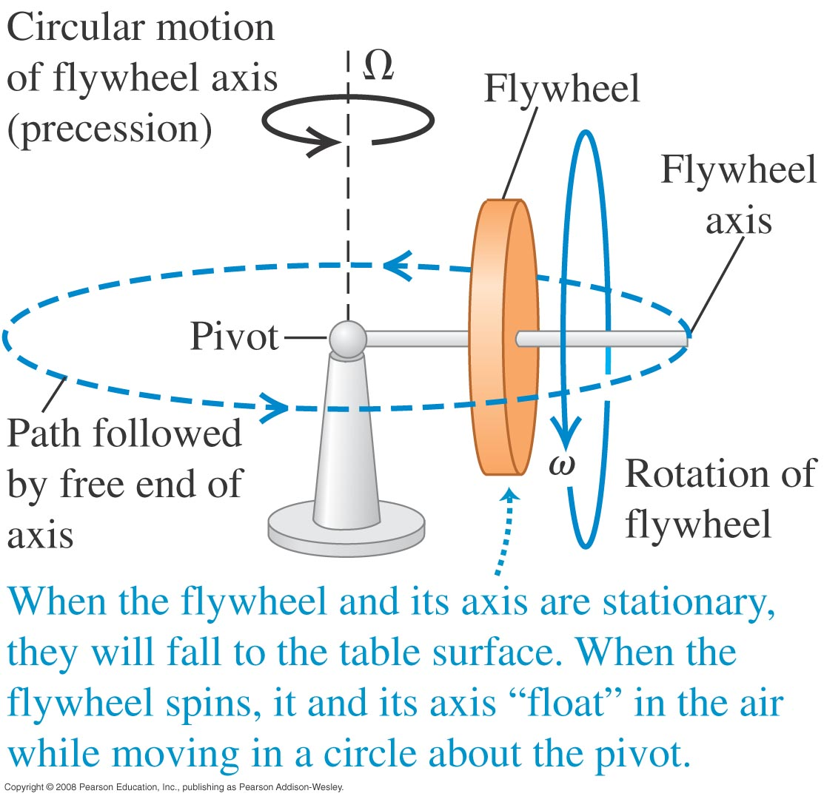
Gyroscopes and precession
For a gyroscope, the axis of rotation changes direction. The motion of this axis is called precession.

Slide 9
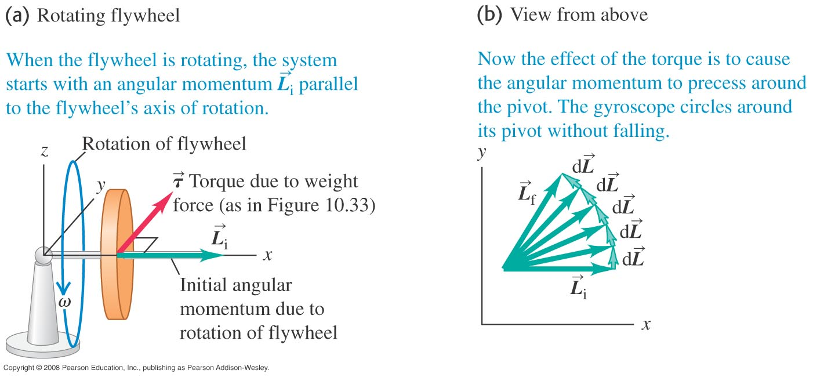
A rotating flywheel
Figure below shows a spinning flywheel. The magnitude of the angular momentum stays the same, but its direction changes continuously.

Slide 10
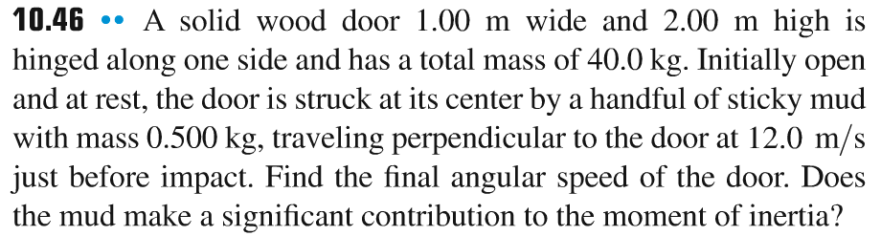
Problem #4

Slide 11
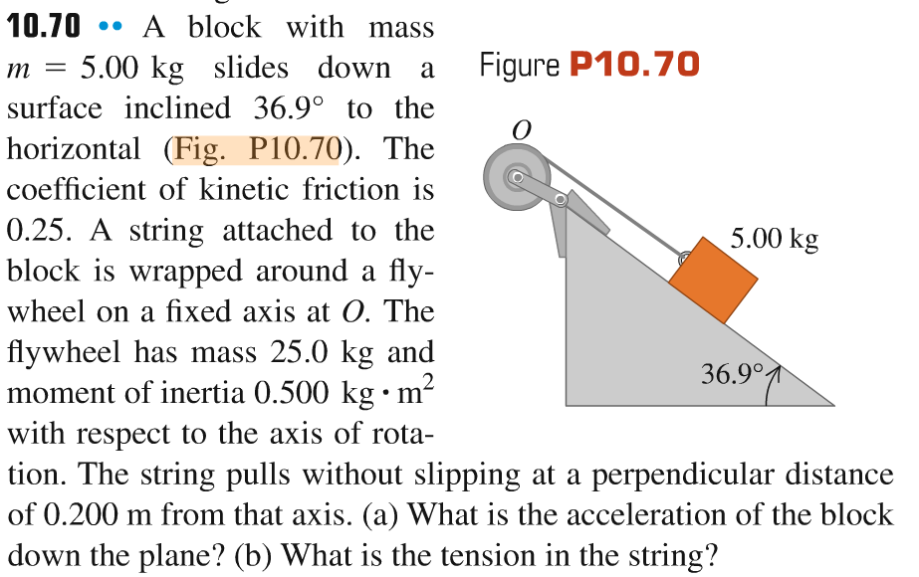
Problem #5

